Slide 1


Slide 2

#LifeKoKaroLift
Data Science
Certification Program
07/11/21
2

Slide 3




Course : Natural Language Processing
Lecture On : Transformers
Instructor : Murtuza Dahodwala
EdEdiitt MMaasstteerr tteexxtt ssttylyleess
07/11/21
3

Slide 4


Today’s Agenda
Revision
Transofmers
Encoder - Block
Decoder - Block
Self Attention
Multi-Head Attention
Doubts
Data Science Certification Program
4

Slide 5
Revision
Applications
Encoders
Decoders
Training
Inference
Attention

Slide 6

RNN
Feed Forward Neural Network rolled out over time

Slide 7
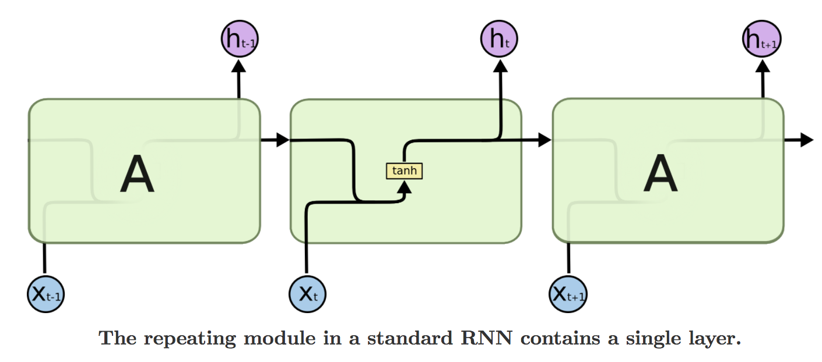
RNN

Slide 8
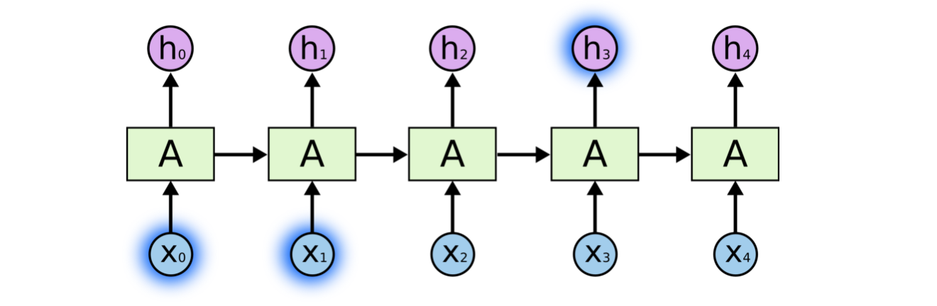
RNN

Slide 9
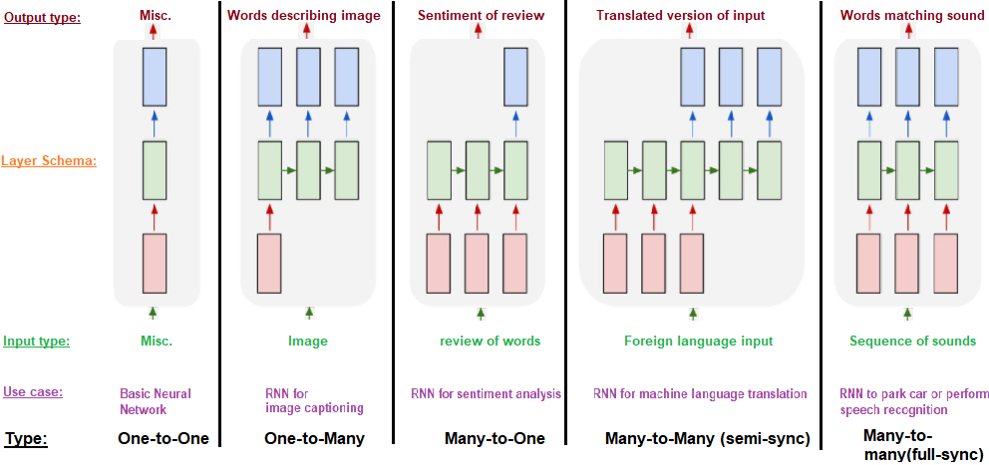
Types of Sequential Networks
5

Slide 10
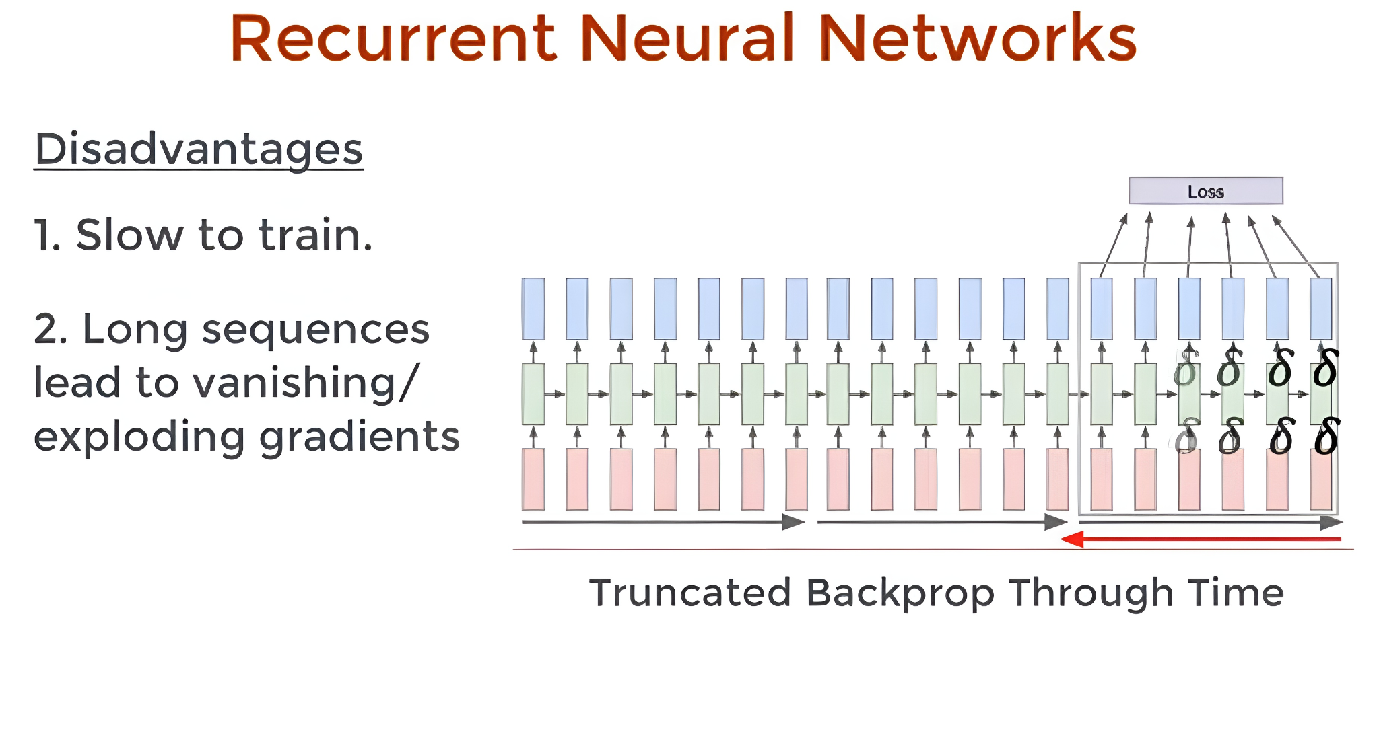
Disadvantages in Seq2Seq

Slide 11
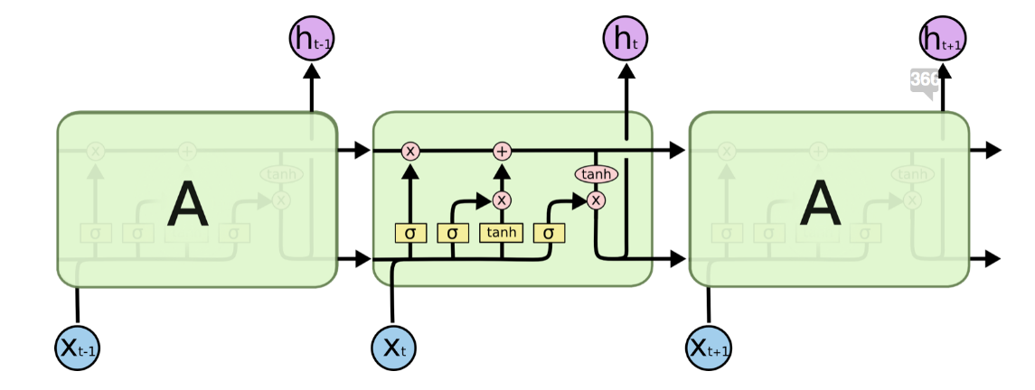
LSTM

Slide 12
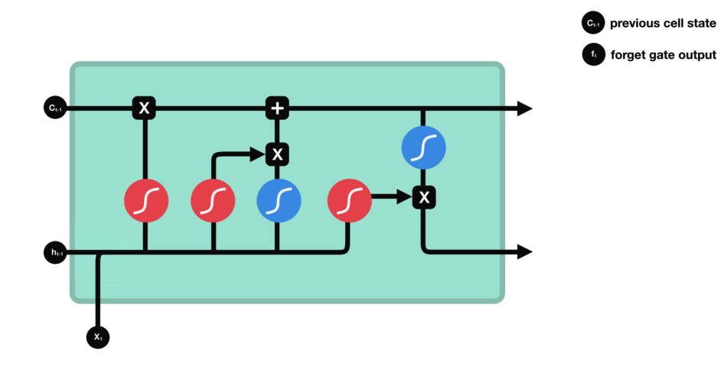
LSTM
Forget Gate

Slide 13
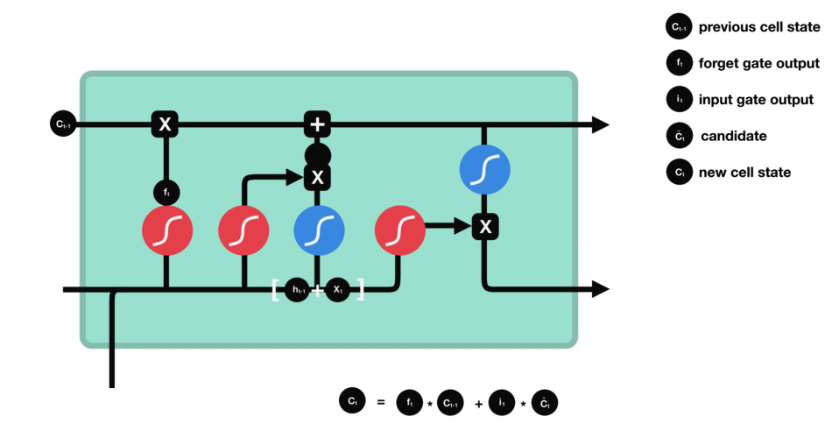
LSTM
Input Gate

Slide 14
LSTM
Cell State

Slide 15

LSTM
Output Gate

Slide 16
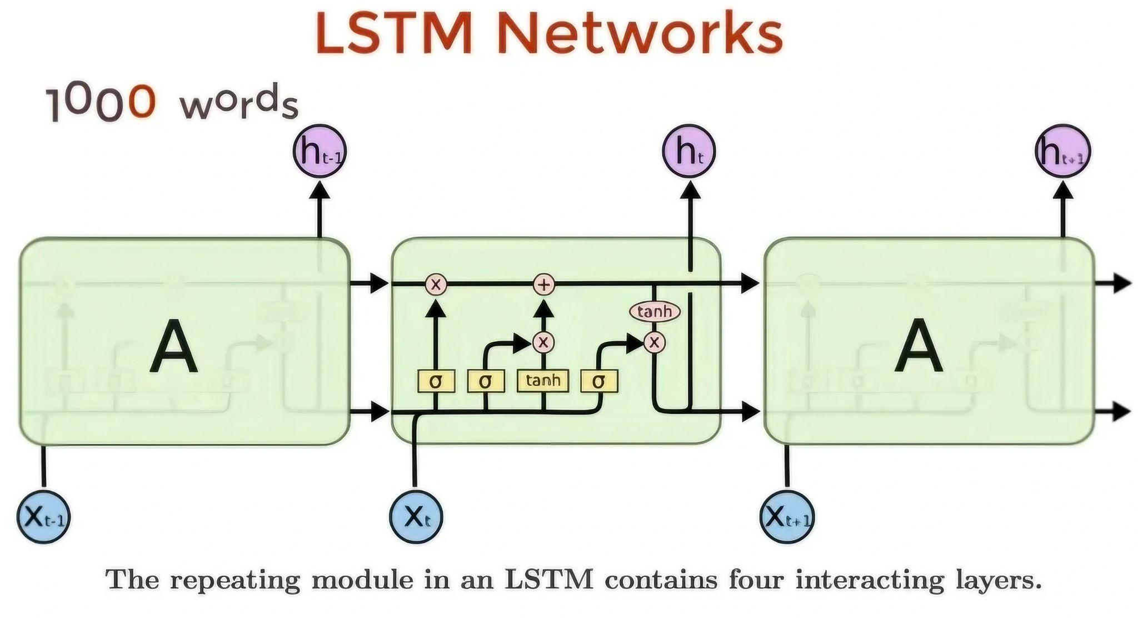
Disadvantages
Specifically designed to solve the Vanisihing/Exploiding Gradient Problem (upto an extent)

Slide 17
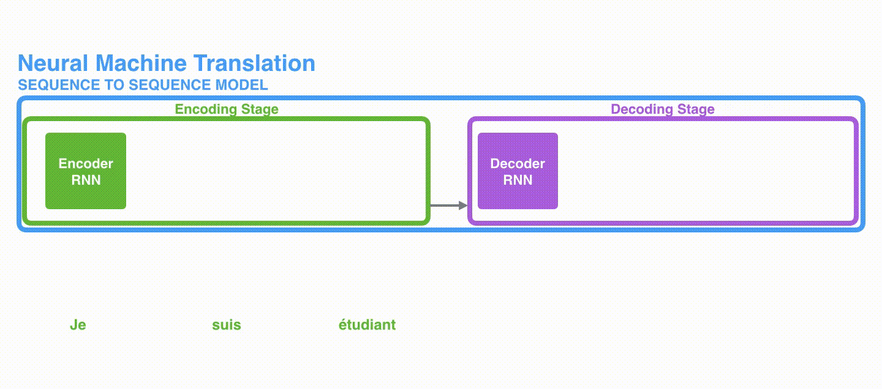
Encoder Decoder
5

Slide 18
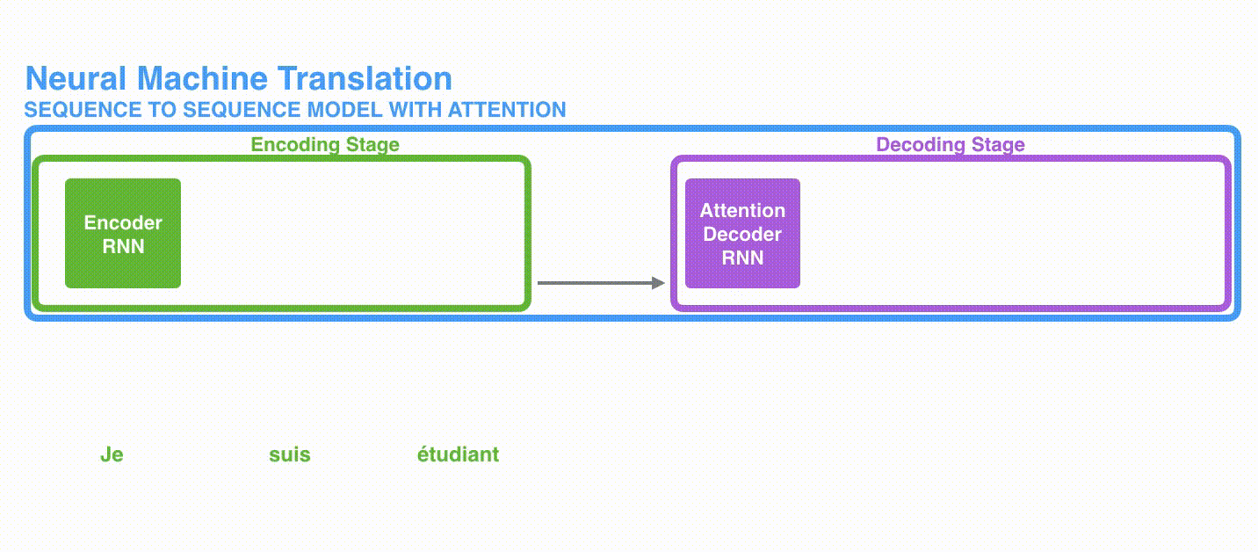
Attention
5

Slide 19
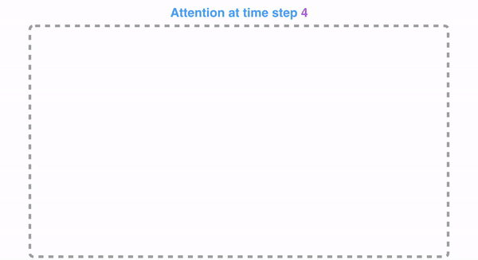
Attention
5

Slide 20
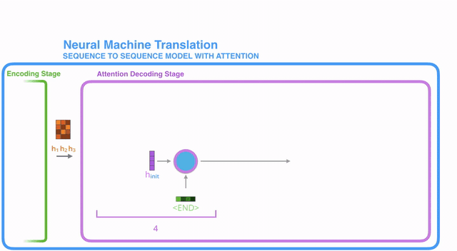
Attention
5

Slide 21
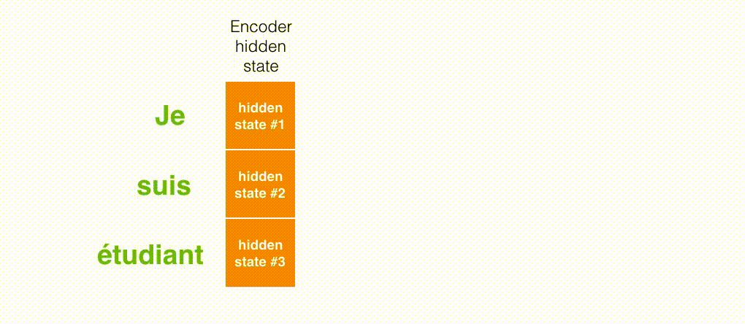
Attention
5

Slide 23
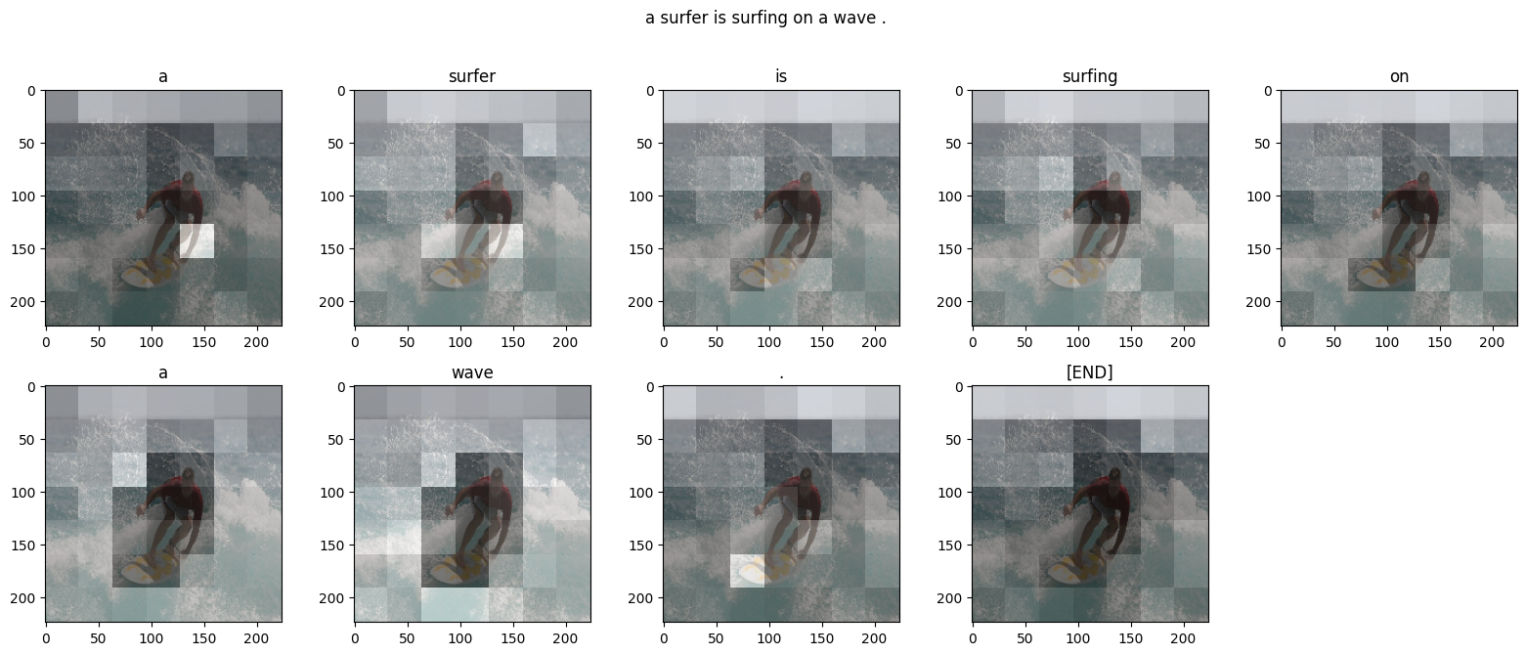
Attention

Slide 24
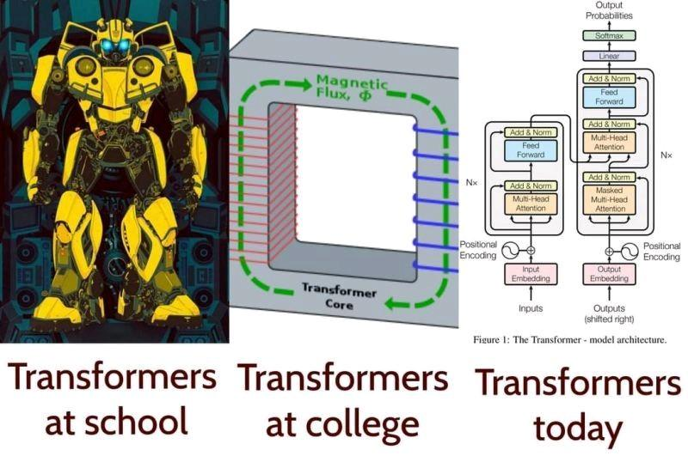
Transformers
5

Slide 25

Transformers

Slide 27
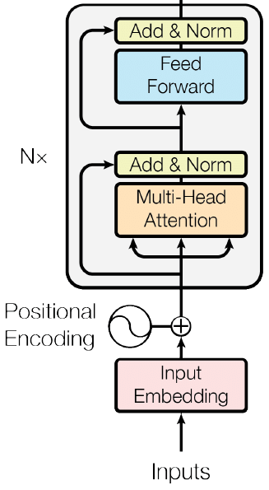
Transformers - Encoder

Slide 29
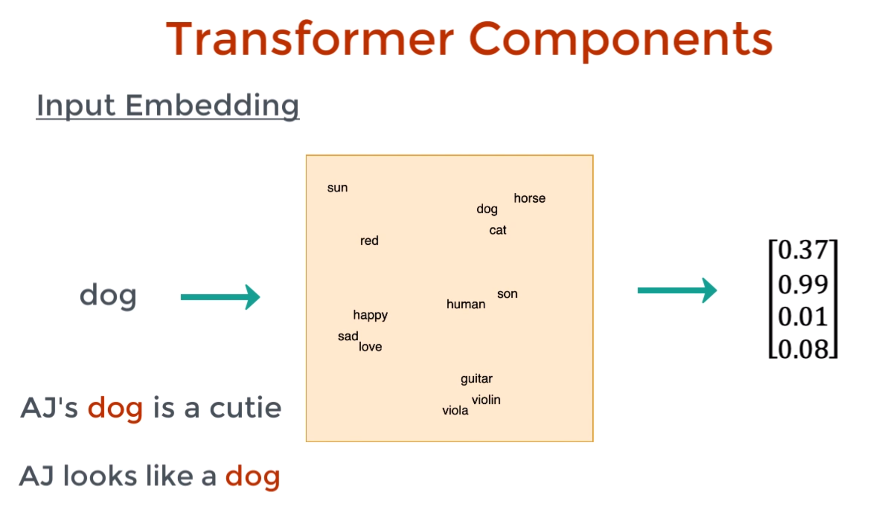
Transformers - Encoder

Slide 31
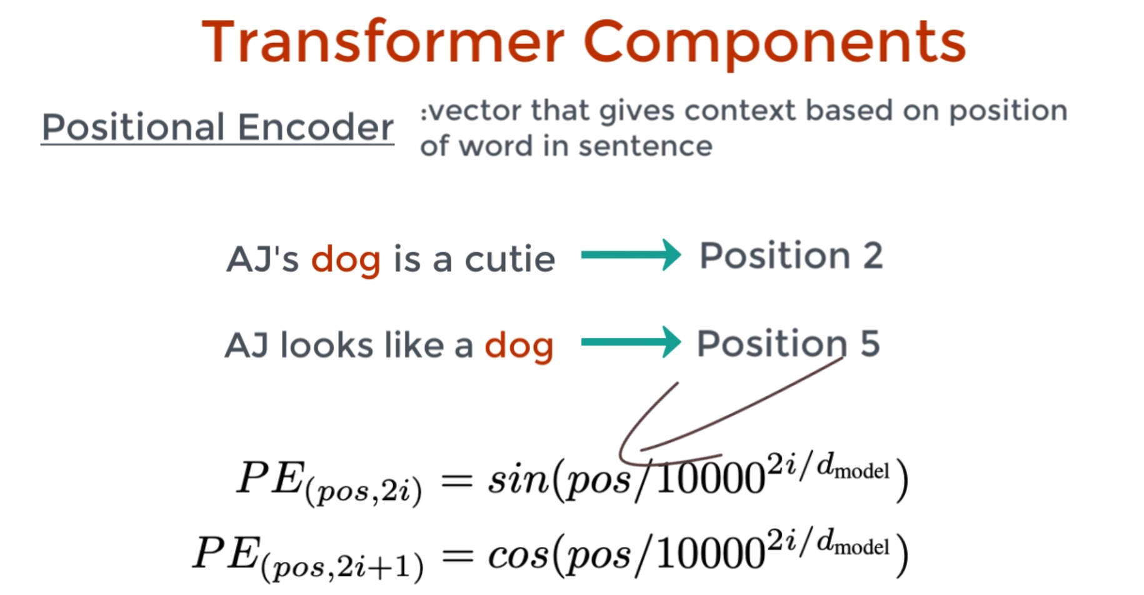
Transformers - Encoder

Slide 33
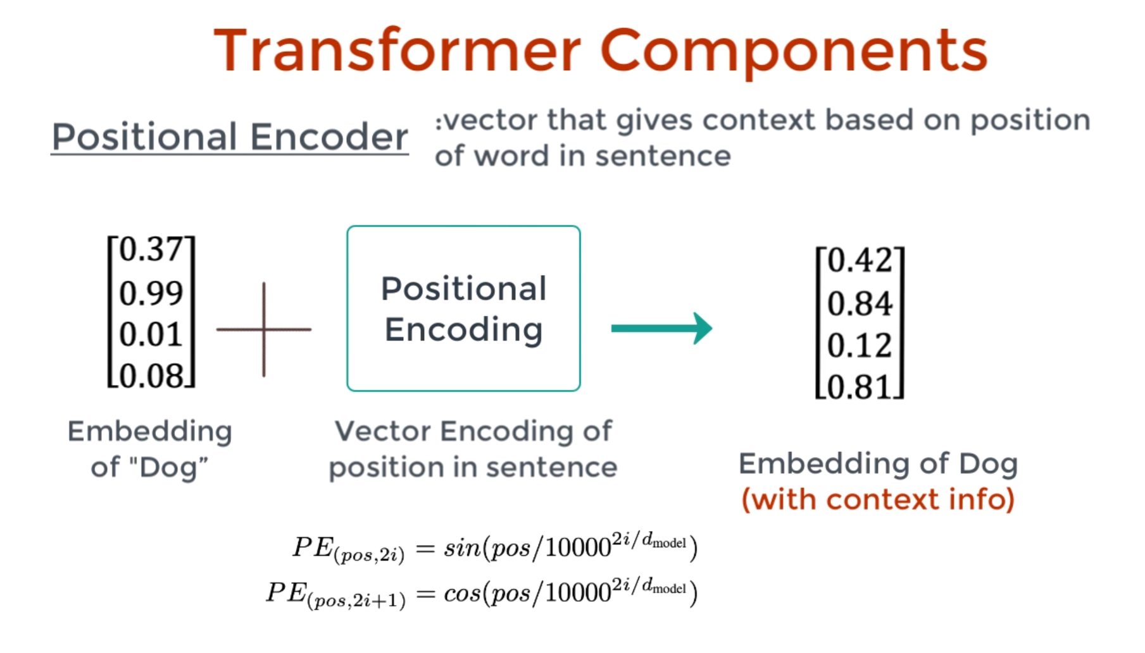
Transformers - Encoder

Slide 35
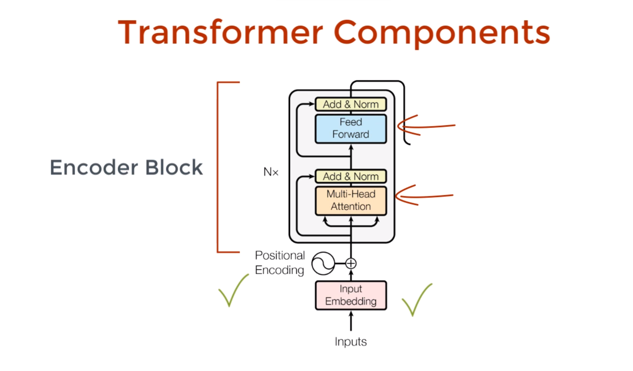
Transformers - Encoder

Slide 37
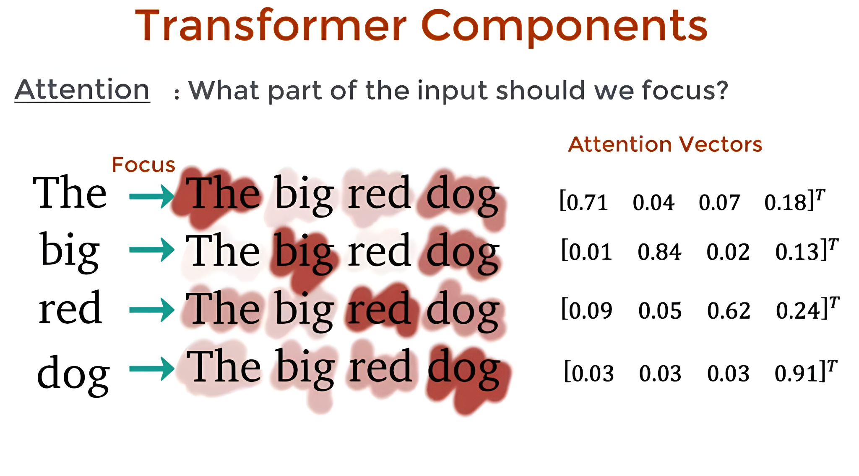
Self Attention

Slide 39
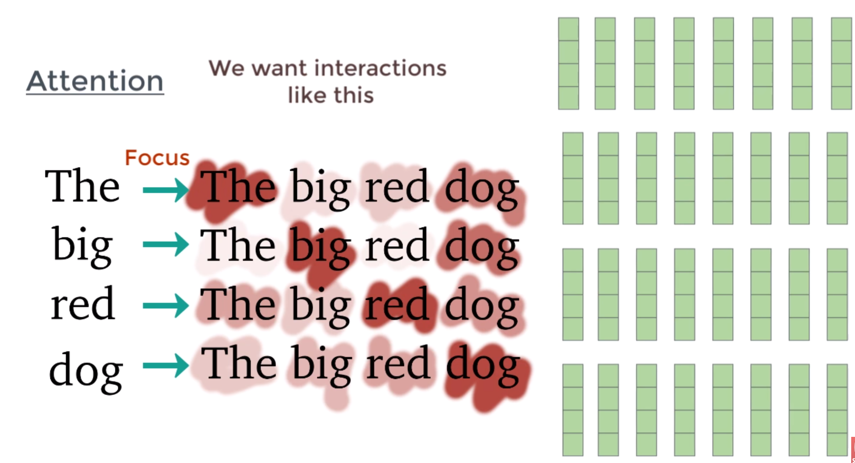
Multi Head Attention

Slide 41
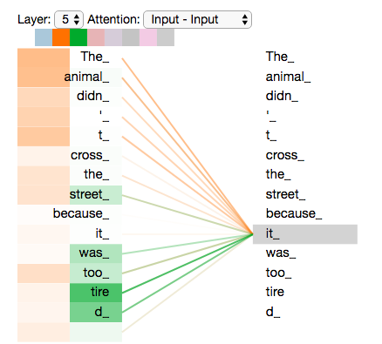
Multi-Head Attention
As we encode the word "it", one attention head is focusing most on "the animal", while another is focusing on "tired" -- in a sense, the model's representation of the word "it" bakes in some of the representation of both "animal" and "tired".

Slide 42
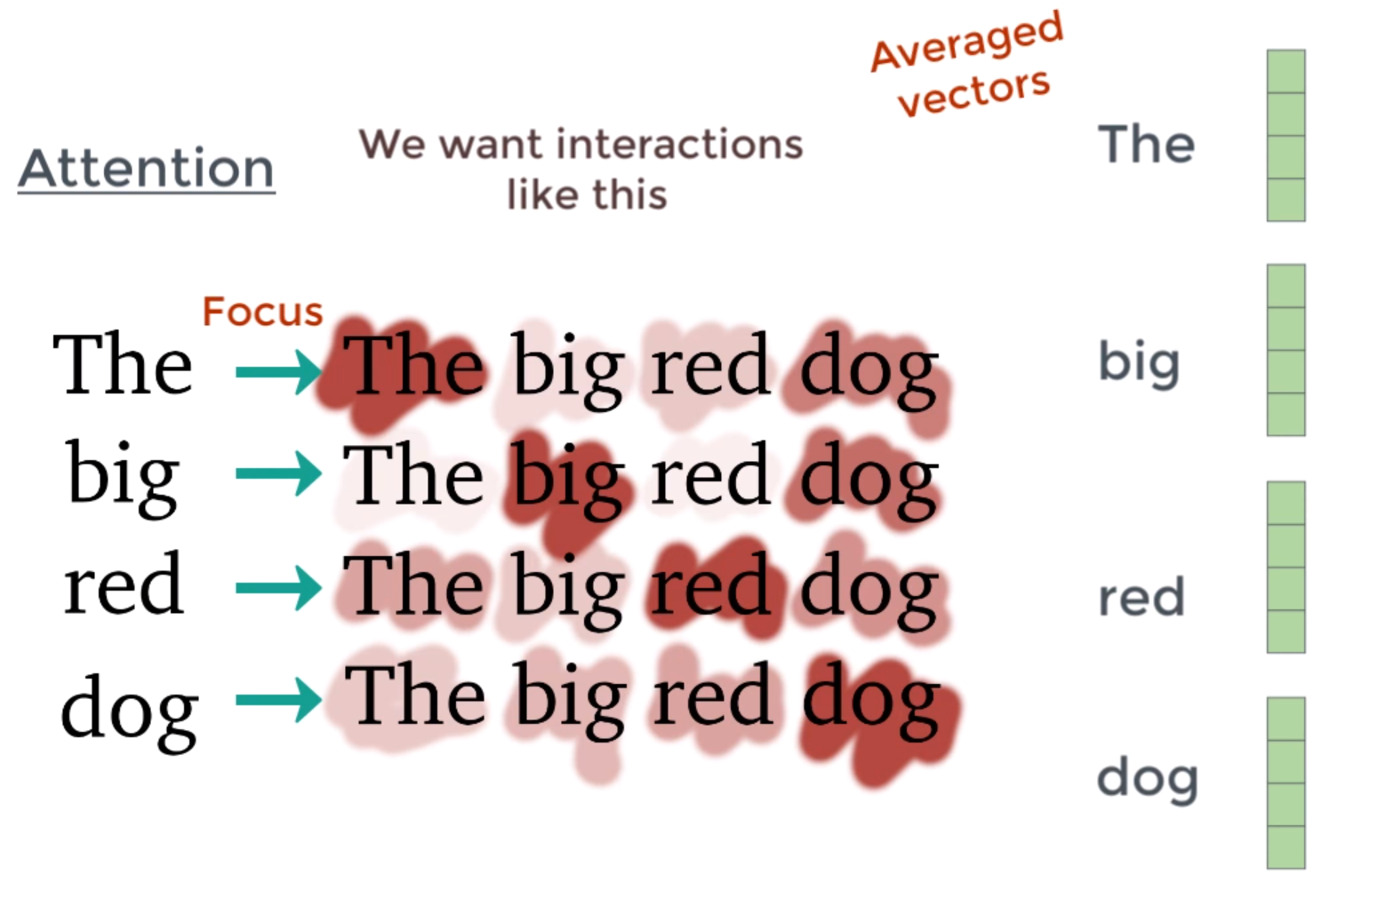
Multi Head Attention

Slide 44
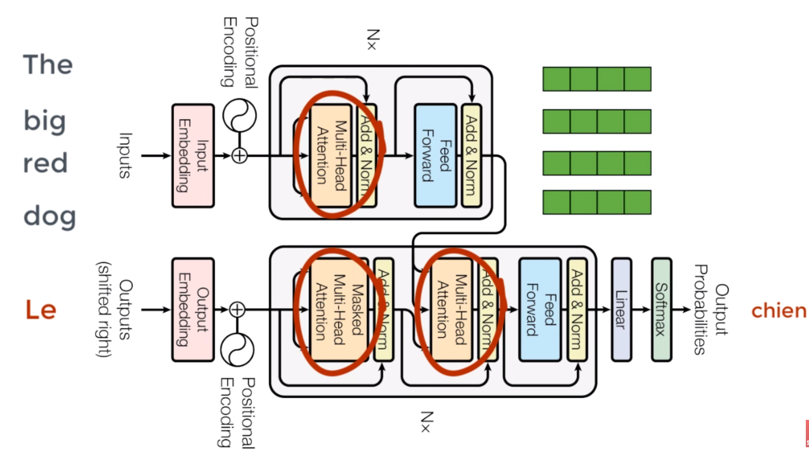
How does Attention Work?

Slide 46
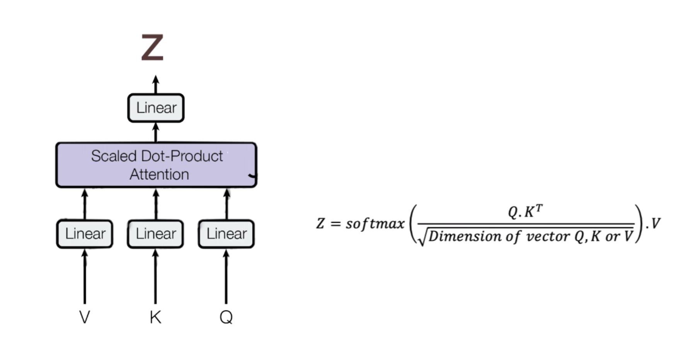
How does Attention Work?
Projections:
Q - Query
K - Key
V - Value

Slide 48
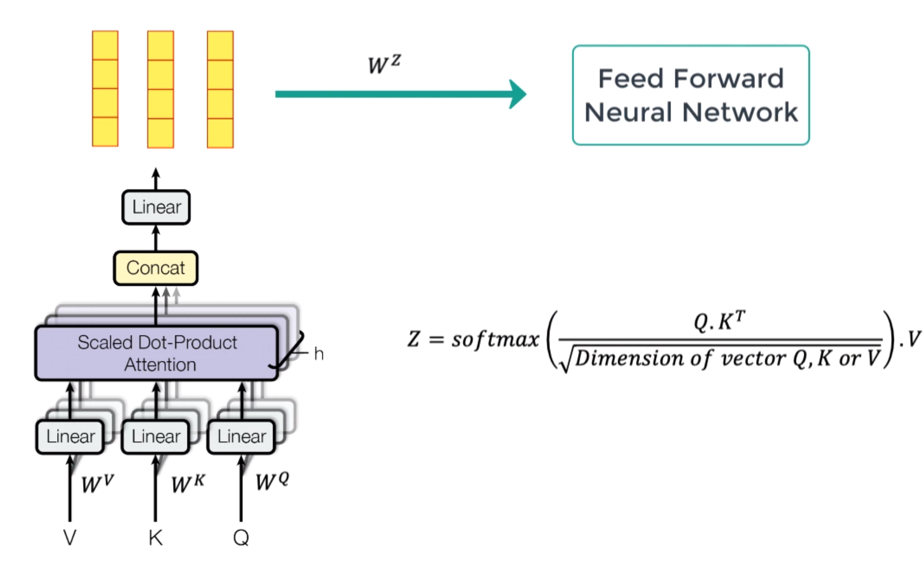
How does Attention Work?

Slide 50
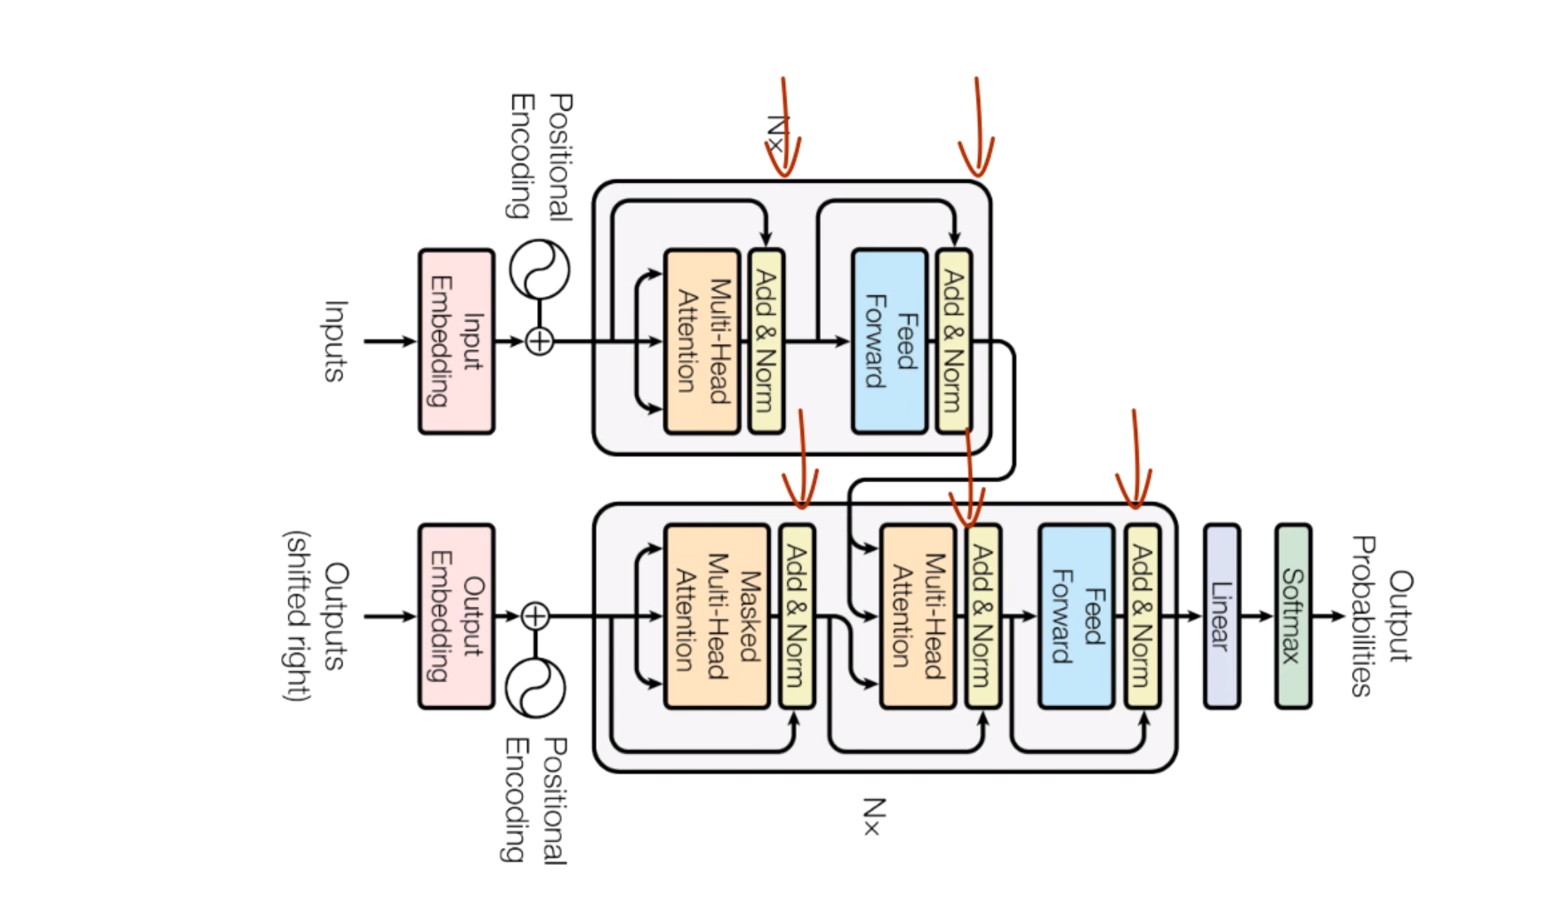
Normalization Layers

Slide 52
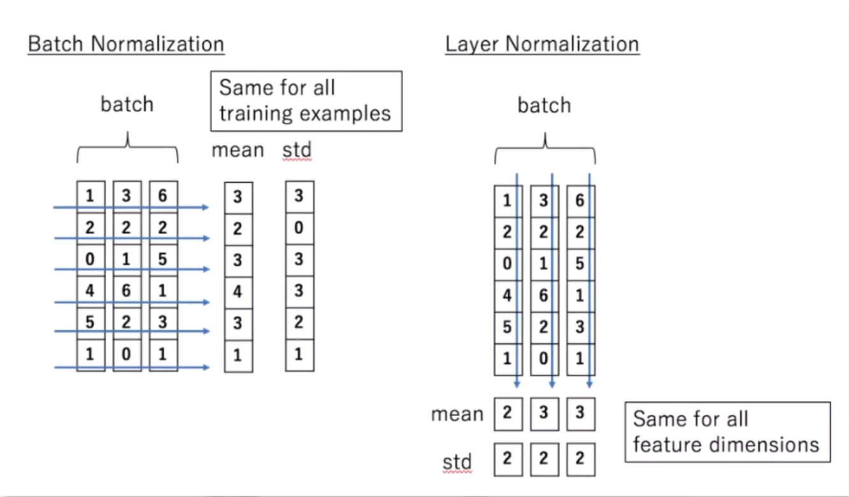
Normalization Layers

Slide 54
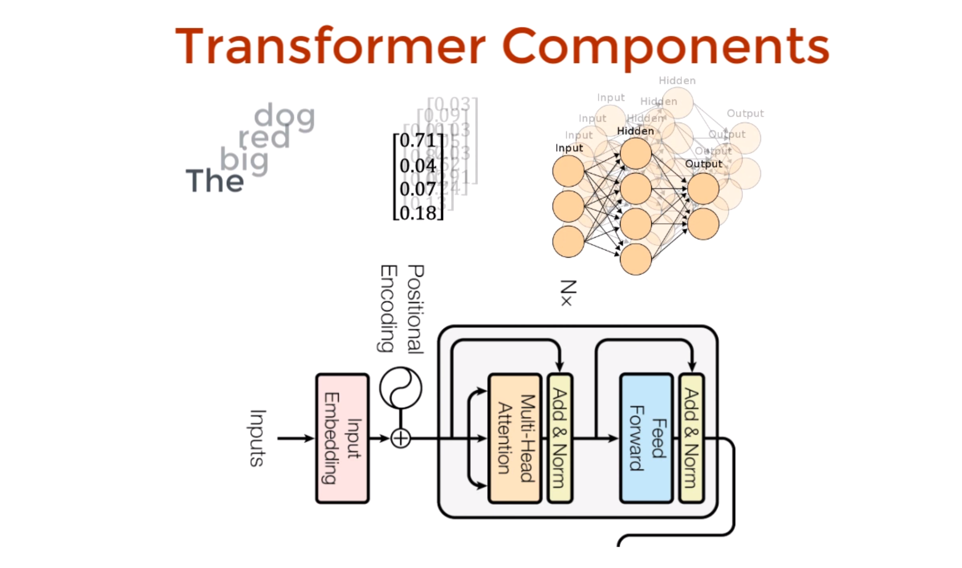
Feed Forward Network

Slide 56
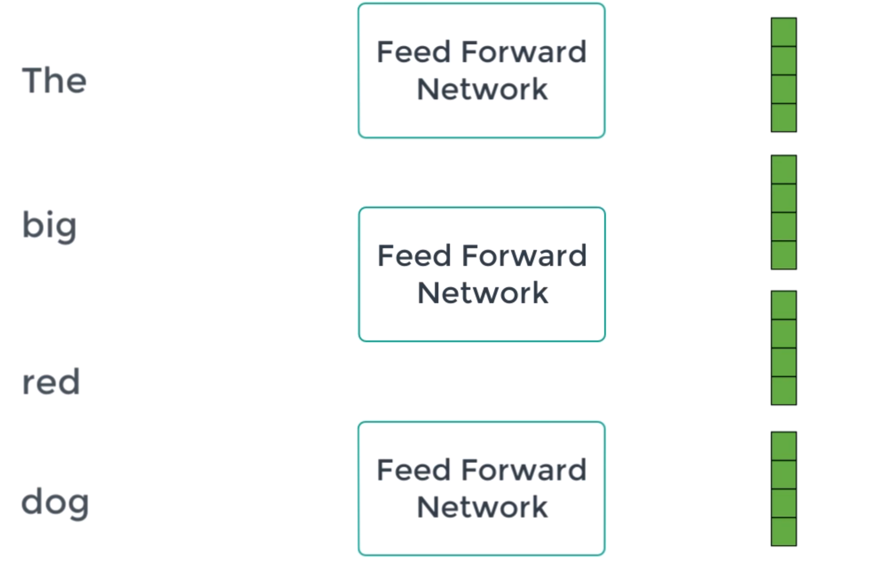
Feed Forward Network

Slide 58
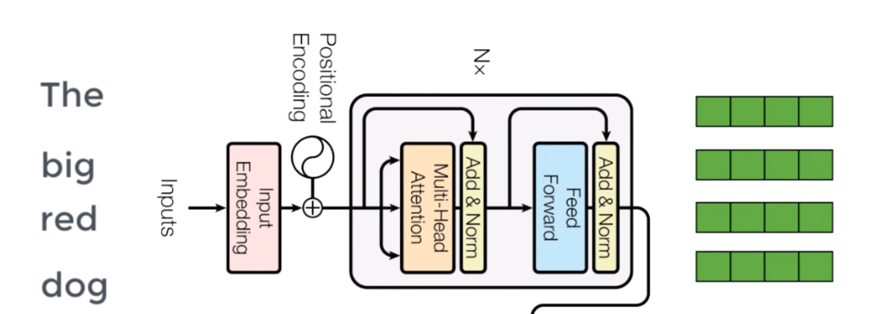
Feed Forward Network

Slide 60
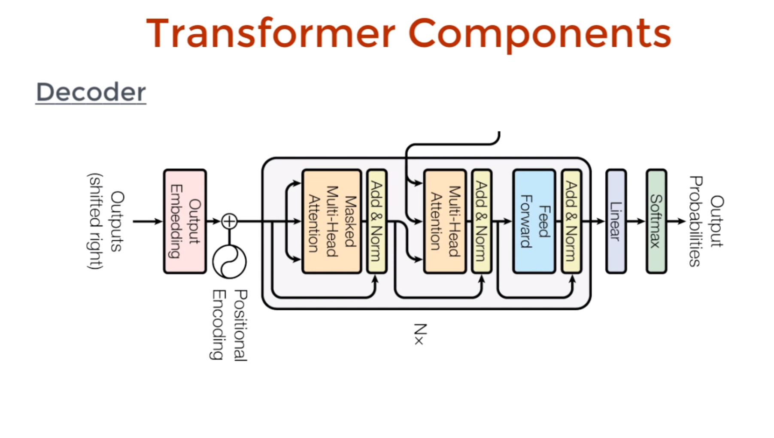
Transformer - Decoder

Slide 62
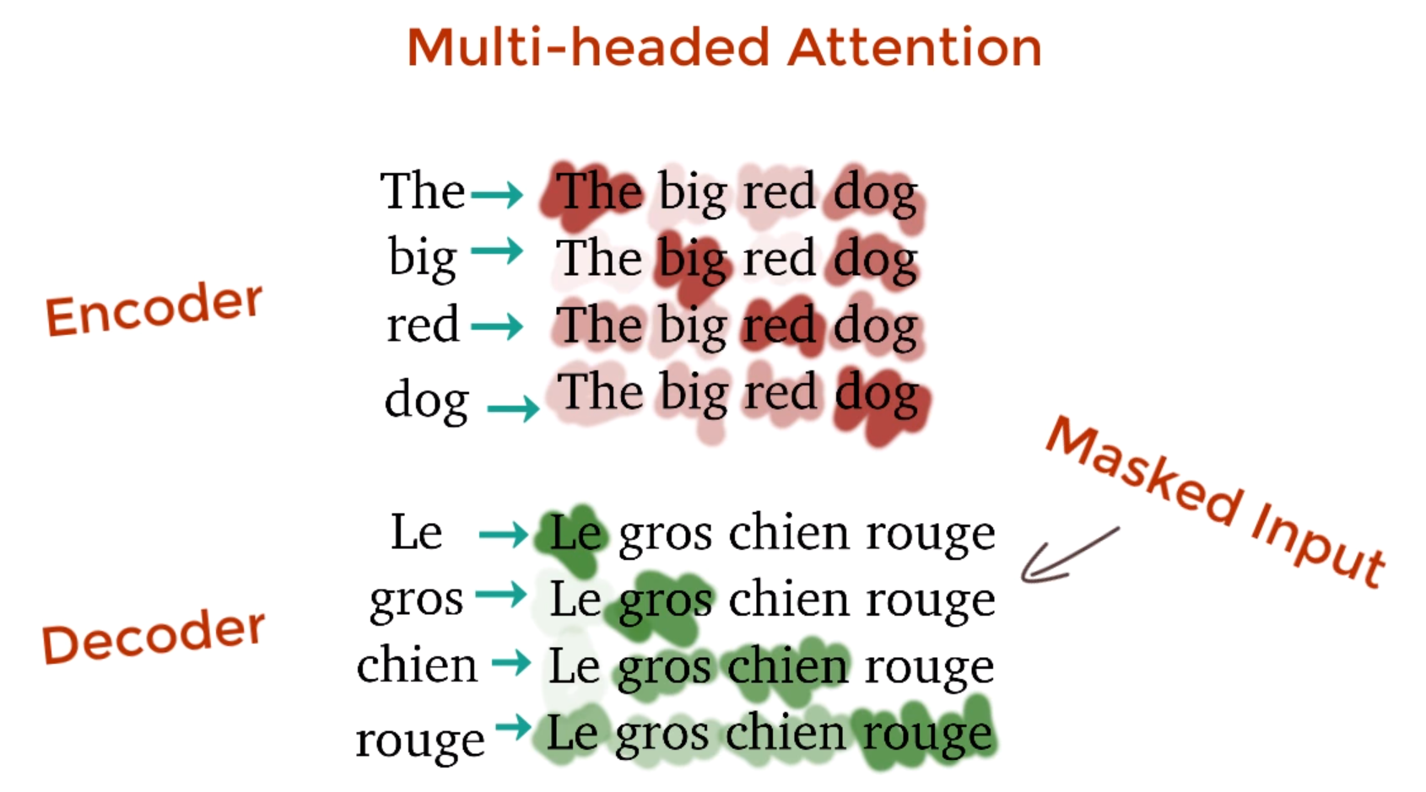
Masked Multi-Head Attention

Slide 64
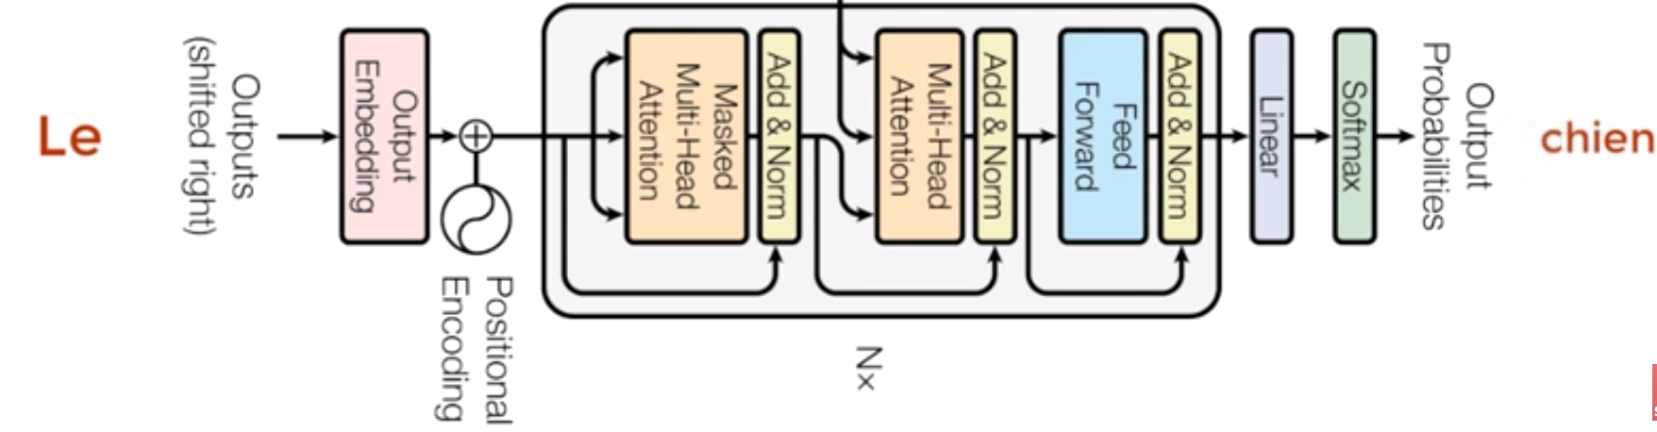
Feed Forward Network

Slide 67

Transformer

Slide 70
References
https://www.youtube.com/watch?v=SysgYptB198
https://www.youtube.com/watch?v=oMeIDqRguLY&t
https://www.youtube.com/watch?v=quoGRI-1l0A
https://jalammar.github.io/illustrated-transformer/
1¹9⁹

Slide 71

Doubts:
07/11/21
1¹9⁹

